Slide 1
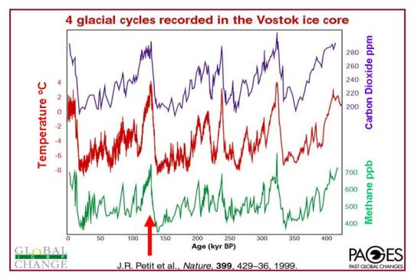
Recap: Two questions for climate modelers
Present Past
Which kinda leads us to two fundamental questions:
Do we have the amplification (feedback) right?
Mechanism
Parameterization
Implementation (algorithm)
What exactly are we trying to represent?

Slide 2

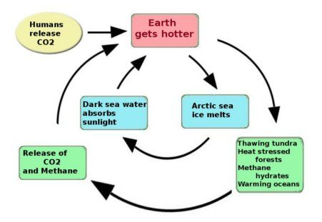
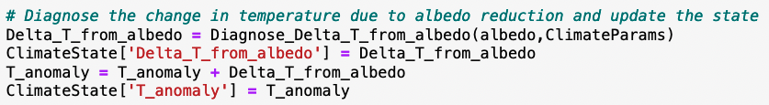
Inside PropagateClimateState
…

Slide 3
Recap: Two questions for climate modelers
Present Past
Which kinda leads us to two fundamental questions:
Do we have the amplification (feedback) right?
Mechanism
Parameterization
Implementation (algorithm)
What exactly are we trying to represent?

Slide 4
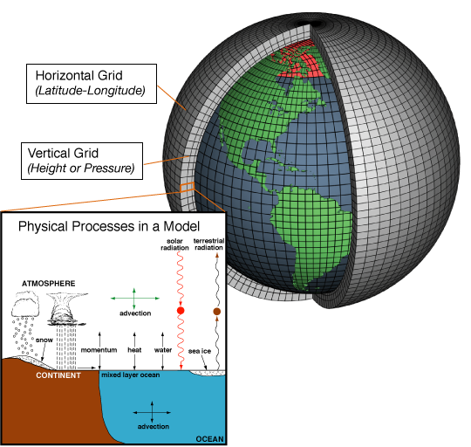
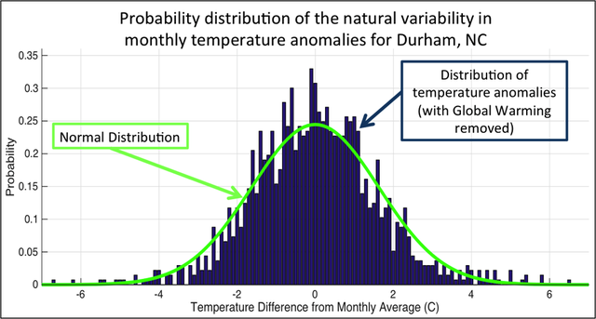
What exactly are we trying to represent?
We’ve seen a lot of geographical variability in the observational record (EdGCM). How about temporal variability at a given location?

Slide 5
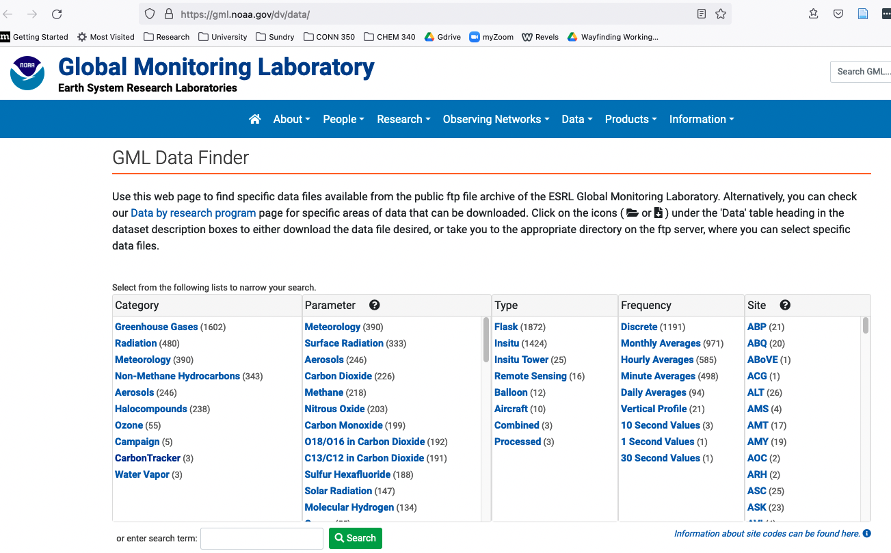
NOAA archive
https://gml.noaa.gov/dv/data/, Navigate to Meteorology, Hourly Averages, BRW (Utquiakvik, formerly Barrow, formerly Utqiagvik)
Data
Metadata

Slide 6
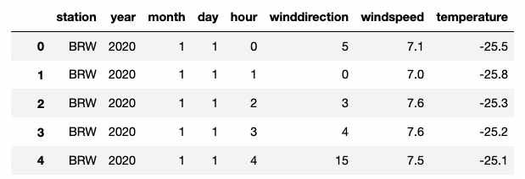
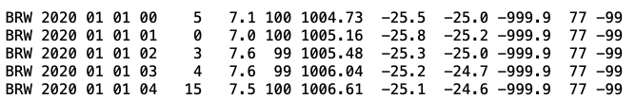
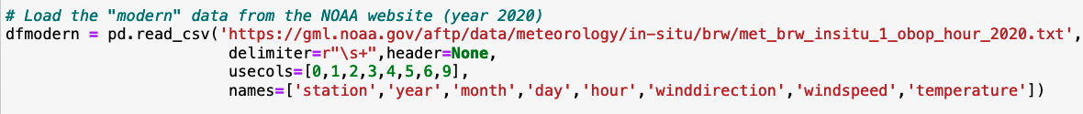
PANDAS can load that kind of data!
dfmodern
NOAA
…
…

Slide 7
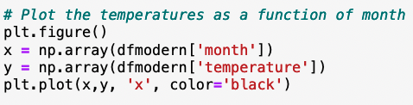
PANDAS dataframes look a lot like regular Python dictionaries
dfmodern
NOAA
…
…

